Slide 1
Analog Vs Digital

Slide 2
ANALOG AND DIGITAL DATA TRANSMISSION
The terms analog and digital correspond to continuous and discrete respectively.
Data as entities that convey meaning, or information.
Signals are electric or electromagnetic representations of data.
Transmission is the communication of data by the propagation and processing of signals.

Slide 3
Analog and Digital Signaling
An analog signal is a continuously varying electromagnetic wave that may be propagated over a variety of media, depending on frequency; examples are copper wire media, such as twisted pair and coaxial cable; fiber optic cable; and atmosphere or space propagation (wireless).

Slide 4

Note:
To be transmitted, data must be transformed to electromagnetic signals.

Slide 5
Note:
Signals can be analog or digital. Analog signals can have an infinite number of values in a range; digital signals can have only a limited number of values.

Slide 6
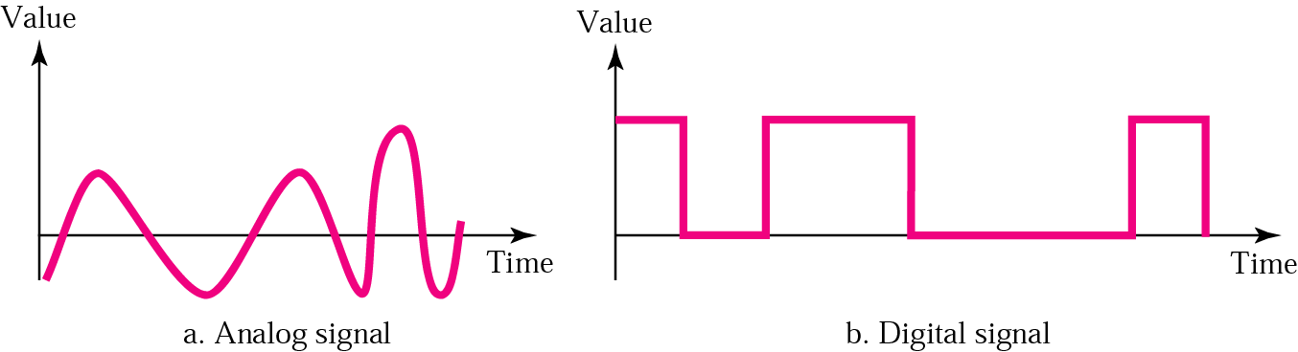
Figure 3.1 Comparison of analog and digital signals

Slide 7
Note:
In data communication, we commonly use periodic analog signals and aperiodic digital signals.

Slide 8
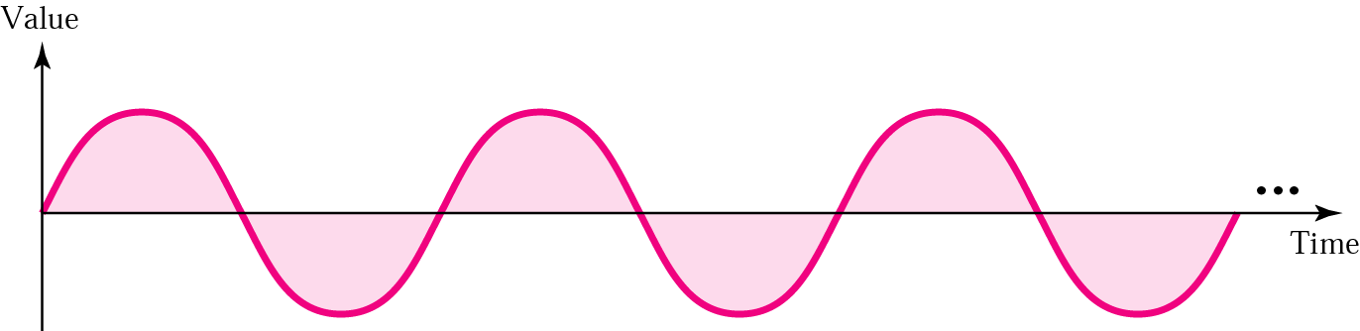
Figure 3.2 A sine wave

Slide 9
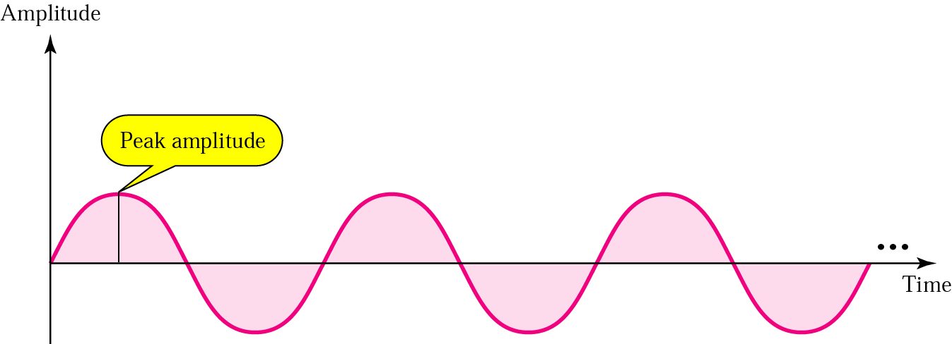
Figure 3.3 Amplitude

Slide 10
Note:
Frequency and period are inverses of each other.

Slide 11
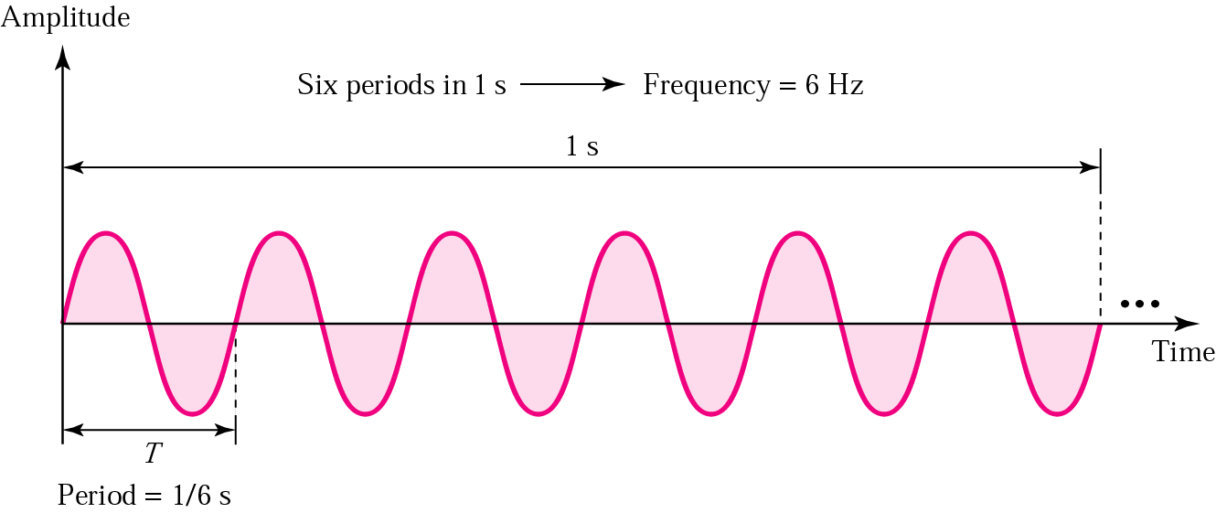
Figure 3.4 Period and frequency

Slide 12
Table 3.1 Units of periods and frequencies
Unit | Equivalent | Unit | Equivalent
Seconds (s) | 1 s | hertz (Hz) | 1 Hz
Milliseconds (ms) | 10^{–3} s | kilohertz (KHz) | 10³ Hz
Microseconds (ms) | 10^{–6} s | megahertz (MHz) | 10⁶ Hz
Nanoseconds (ns) | 10^{–9} s | gigahertz (GHz) | 10⁹ Hz
Picoseconds (ps) | 10^{–12} s | terahertz (THz) | 10¹² Hz

Slide 13
Example 1
Express a period of 100 ms in microseconds, and express the corresponding frequency in kilohertz.
Solution
From Table 3.1 we find the equivalent of 1 ms.We make the following substitutions:
100 ms = 100 × 10⁻³ s = 100 × 10⁻³ × 10⁶ μs = 10⁵ μs
Now we use the inverse relationship to find the frequency, changing hertz to kilohertz
100 ms = 100 × 10⁻³ s = 10⁻¹ s
f = 1/10⁻¹ Hz = 10 × 10⁻³ KHz = 10⁻² KHz

Slide 14
Note:
Frequency is the rate of change with respect to time. Change in a short span of time means high frequency. Change over a long span of time means low frequency.

Slide 15
Note:
If a signal does not change at all, its frequency is zero. If a signal changes instantaneously, its frequency is infinite.

Slide 16
Note:
Phase describes the position of the waveform relative to time zero.

Slide 17
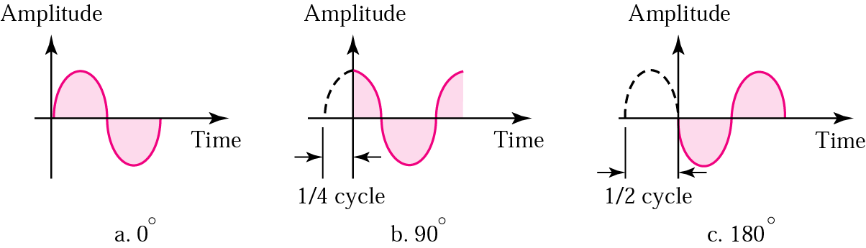
Figure 3.5 Relationships between different phases

Slide 18
Note:
An analog signal is best represented in the frequency domain.

Slide 19
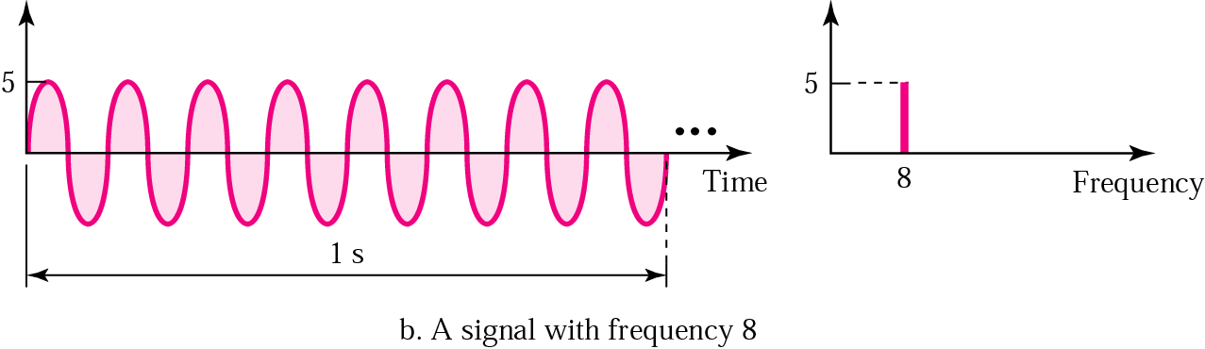
Figure 3.7 Time and frequency domains (continued)

Slide 20
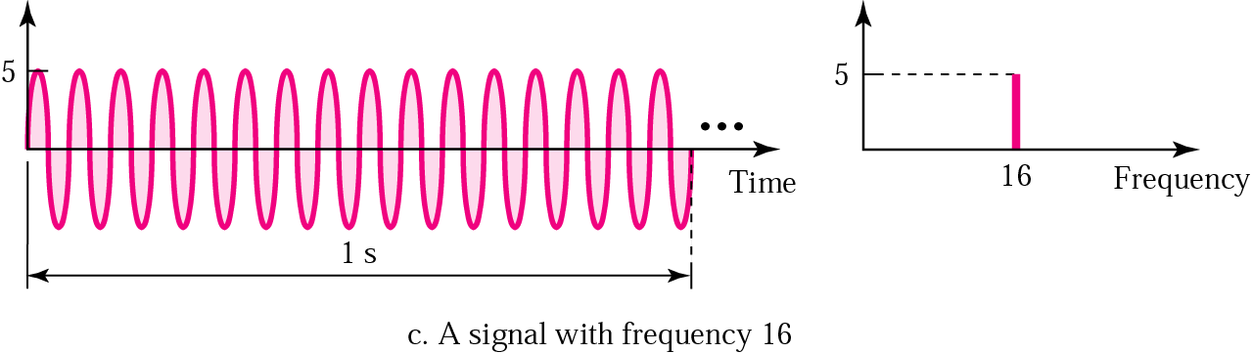
Figure 3.7 Time and frequency domains (continued)

Slide 21
Digital Signals

Slide 22
Digital Signaling
A digital signal is a sequence of voltage pulses that may be transmitted over a copper wire medium; for example, a constant positive voltage level may represent binary 0 and a constant negative voltage level may represent binary 1.

Slide 23
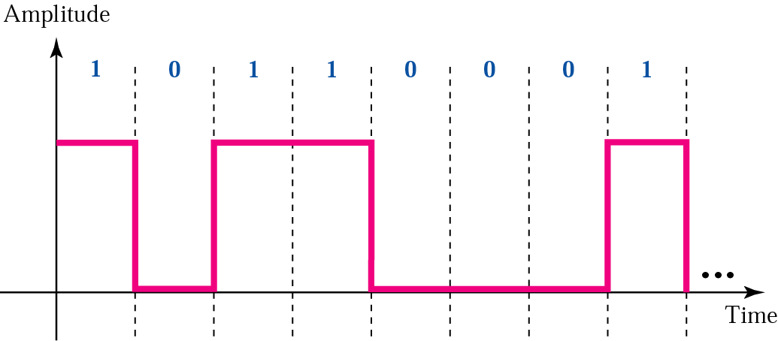
Figure 3.16 A digital signal

Slide 24
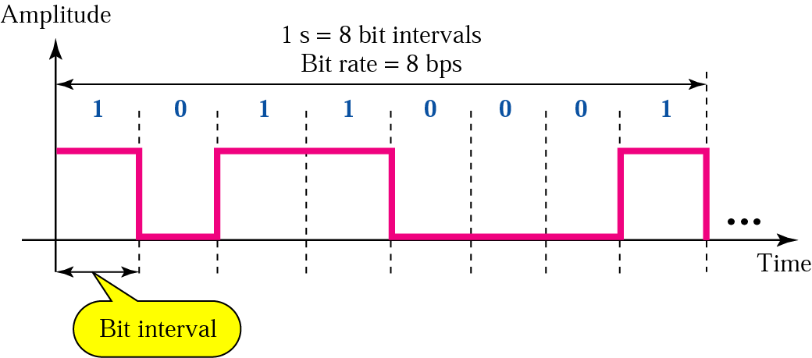
Figure 3.17 Bit rate and bit interval

Slide 25
Example 6
A digital signal has a bit rate of 2000 bps. What is the duration of each bit (bit interval)
Solution
The bit interval is the inverse of the bit rate.
Bit interval = 1/ 2000 s = 0.000500 s
= 0.000500 x 10⁶ μs = 500 μs

Slide 26
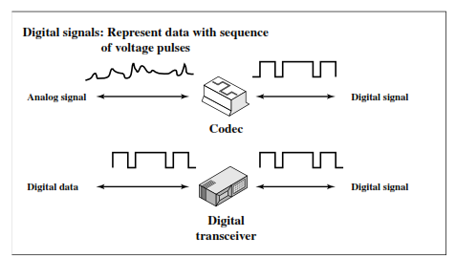

Slide 27
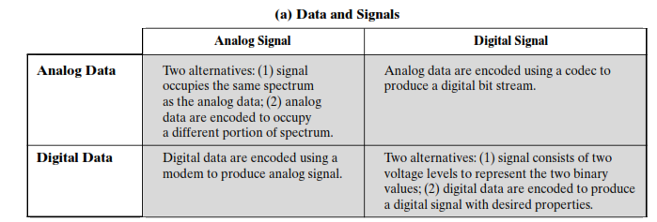

Slide 28

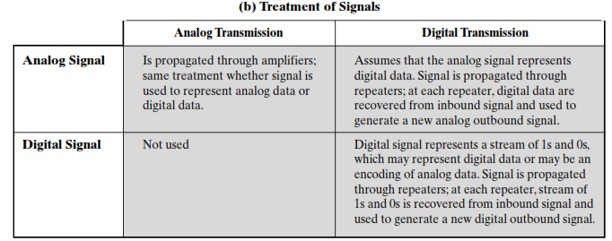

Slide 29
CHANNEL CAPACITY
There are four concepts here that we are trying to relate to one another:
Data rate: This is the rate, in bits per second (bps), at which data can be communicated.
Bandwidth: This is the bandwidth of the transmitted signal as constrained by the transmitter and the nature of the transmission medium, expressed in cycles per second, or Hertz.
Noise: For this discussion, we are concerned with the average level of noise over the communications path.
Error rate: This is the rate at which errors occur, where an error is the reception of a 1 when a 0 was transmitted or the reception of a 0 when a 1 was transmitted.

Slide 30
Note:
The bit rate and the bandwidth are proportional to each other.

Slide 31
Note:
The analog bandwidth of a medium is expressed in hertz; the digital bandwidth, in bits per second.

Slide 32
3.6 Transmission Impairment
Attenuation
Distortion
Noise

Slide 33
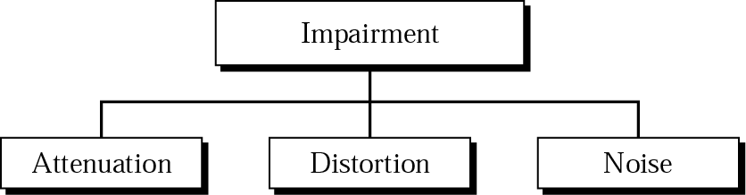
Figure 3.20 Impairment types

Slide 34
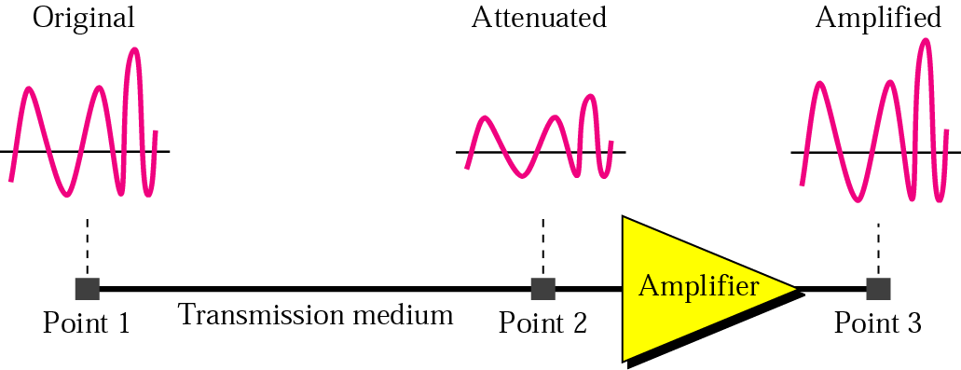
Figure 3.21 Attenuation

Slide 35
3.7 More About Signals
Throughput
Propagation Speed
Propagation Time
Wavelength

Slide 36
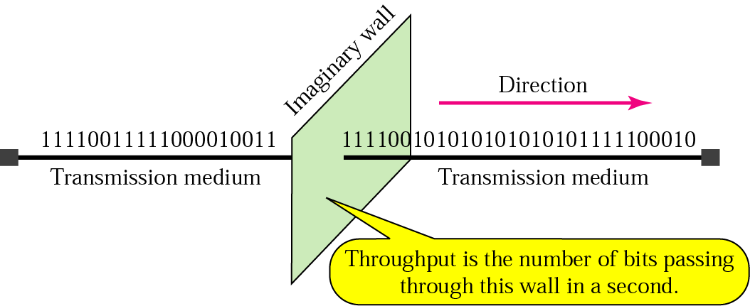
Figure 3.25 Throughput

Slide 37
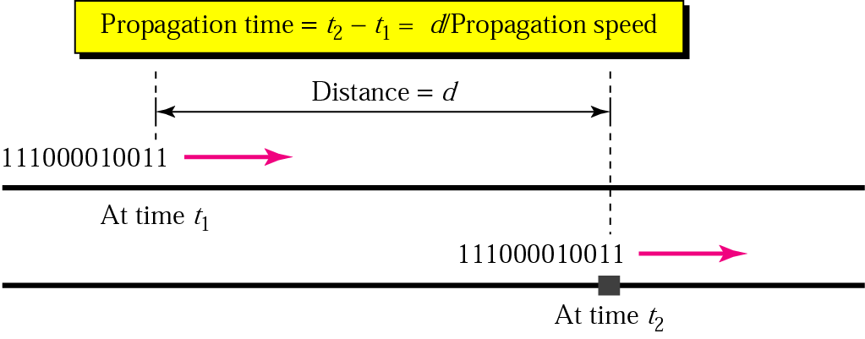
Figure 3.26 Propagation time

Slide 38
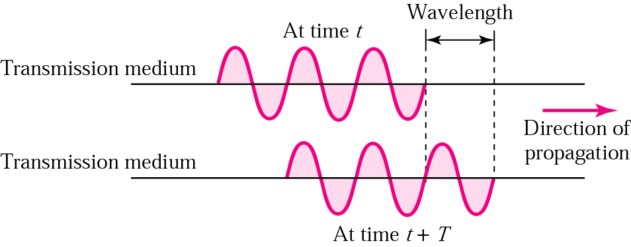
Figure 3.27 Wavelength

